Slide 1

Building a calculator

Slide 2
Recap
Installed Thonny
print(“Hello world”)
Variables
variable = “hello world”
print(variable)
input(“Enter something: ”)
if & else statement
while() loop
int(input())

Slide 3




Example
What does this mean?

Slide 4
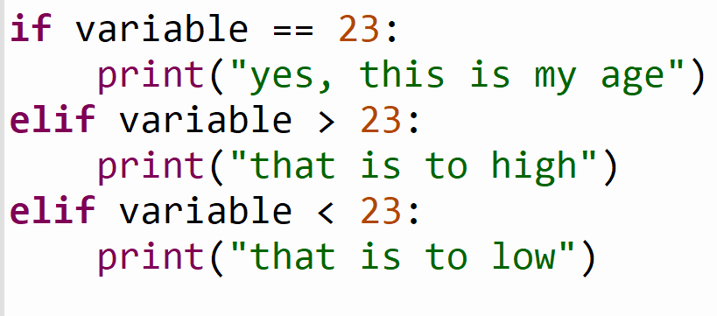
Example
What will the elif do?

Slide 5
Calculator
What do we need to build a calculator?
2 numbers
An operator (+, -, /, *)
An output

Slide 6
Calculator
What do we use from our Python knowledge?
print()
input()
variables
if & elif & else
int()
while() (optional)

Slide 7
Assignment build the calculator (30 min)
There are 3 inputs, 2 numbers and 1 operator(+, -, *, /)
Check the inputs on one of the inputs.
print the result like this: (1 + 1 = 2) or (2 * 2 = 4)
Optional:
Use the while loop
Extend it with square and/or root (google this)

Slide 8
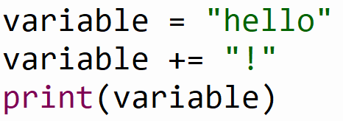
Example
What will the += do?

Slide 9
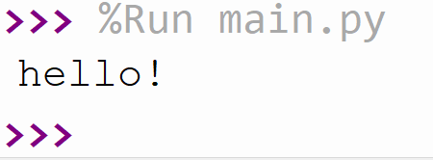
Example

Slide 10
Example
What will the += do?

Slide 11
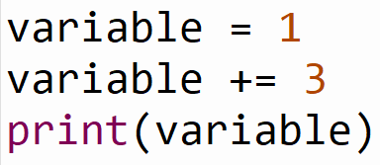
Example
What will the += do?

Slide 12
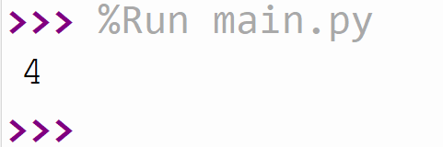
Example

Slide 13
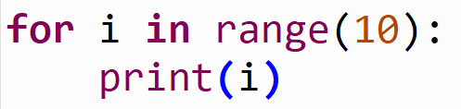
Example
What do you think this will do?

Slide 14
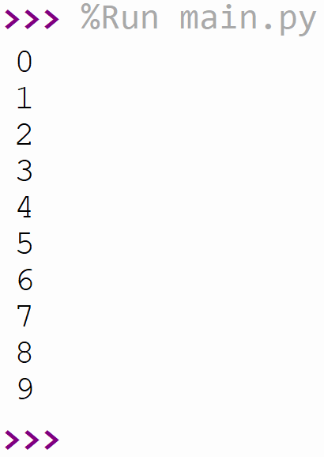
Example
A loop from 0 to 10

Slide 15
Assignment triangular number (25 min)
This assignment is the same as the previous but now you need to figure something out yourself.
Create a for loop that goes from 1 until the number given by the user.
So if the user gives 5 as in input the result must be:
1 + 2 + 3 + 4 + 5 = 15
15 should be printed

Slide 16
Summary
elif statement
variable += “string” / += 1
for loop
How to google a problem
Created a simple calculator
Created a for loop that calculates a triangular number

